Slide 1
Camino de Santiago

Slide 2
Camino de Santiago The Way of St James
Legend - St James’s remains were carried by boat from Jerusalem to Santiago de Compostela
Important Christian pilgrimage during the Middle Ages
Symbol of Camino - the scallop shell
Notes:
For more than a thousand years pilgrims have walked this trail across northern Spain and every year more and more people join that number.
Known in English as The Way of Saint James, it was an important pilgrimage made in medieval times. It is believed that the remains of Saint James were carried from Jerusalem to Spain along this path before being buried where the city of Santiago de Compostela now stands, the end point for the pilgrimage walk. The cathedral was built in the 9th century.

Slide 3
The Routes
Camino Frances (French route)
Northern route (Spain - coast)
Via de la Plata (Silver Route - Seville)
Portuguese route (Lisbon)
English route (port of Ferrol)
Notes:
There are five main routes
Camino Frances This is the most popular of all the Camino Routes. It starts in St Jean Pied de Port in the foothill of the Pyrenees in the south of France.
Northern Route
Follows the North coast of Spain, from the French border in Irun
Via de la Plata (Silver Route) Following an old Roman road this way leads south to north starting in Seville, or alternatively in Granada. The Silver Route is about 620 miles (1000km) and normally takes 6 or 7 weeks walking. As facilities along this route improve it is becoming a popular alternative to the increasingly busy Camino Frances.
English Route
The medieval pilgrims from the North, who were mostly English would disembark in the ports of A Coruña or Ferrol, on the north coast of Spain and begin their pilgrimage to Santiago de Compostela from there. Hence, the name, the English Way.

Slide 4
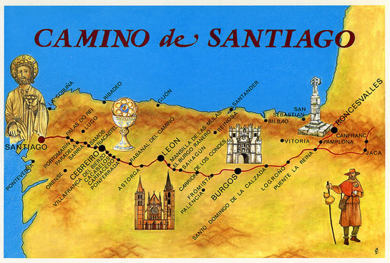
500 miles = 800 KM
Notes:
The first day of walking was about 15 miles up over the Pyrenees - so right from the start it was quite tough. The terrain throughout the walk was varied - there were mountains and hills, forests, woods, rivers and the route went through towns, villages, and cities such as Pamplona, Burgos and Leon.
There was also an area known as the Meseta (the desert) – the area between Burgos and Leon. This was very flat and arable - and it was hot. There was a straight Roman Road which felt like it was going on forever! It took me 4 days to cross the Meseta.

Slide 5
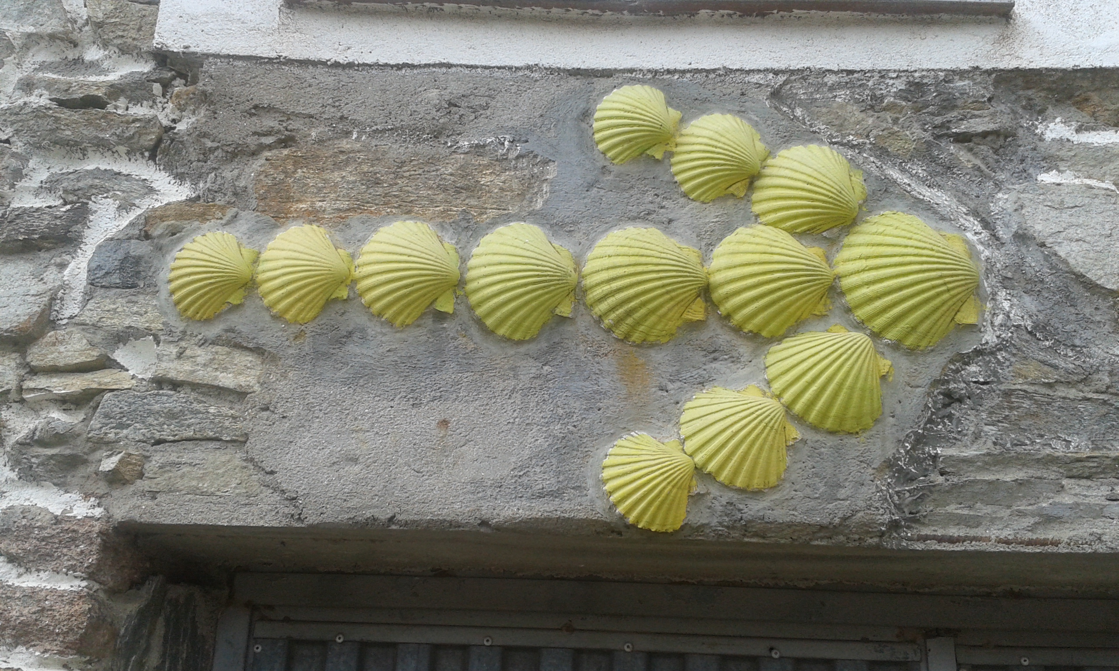

Slide 6
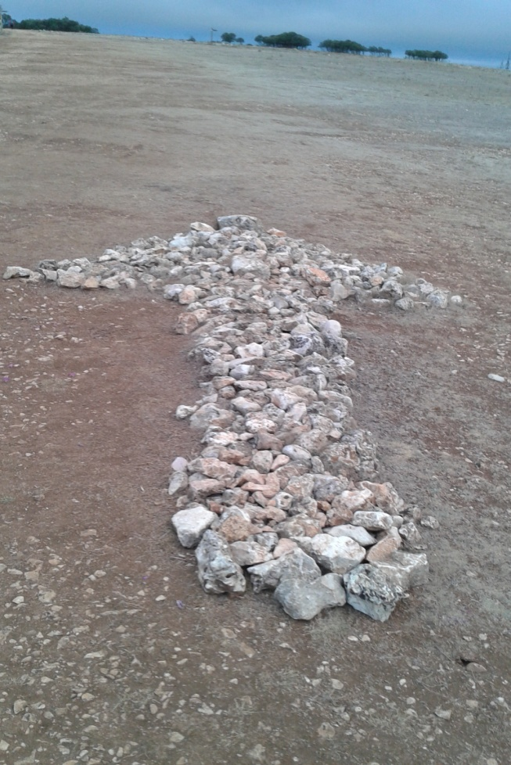
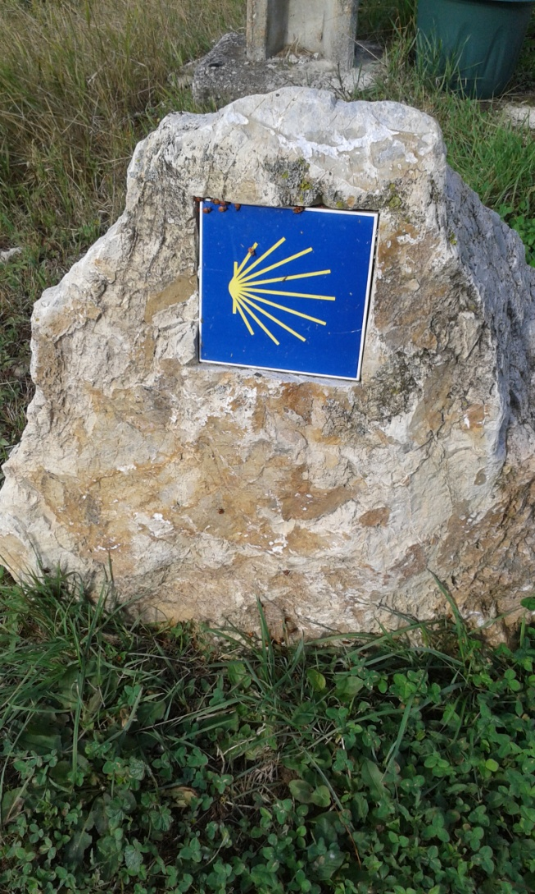

Slide 7
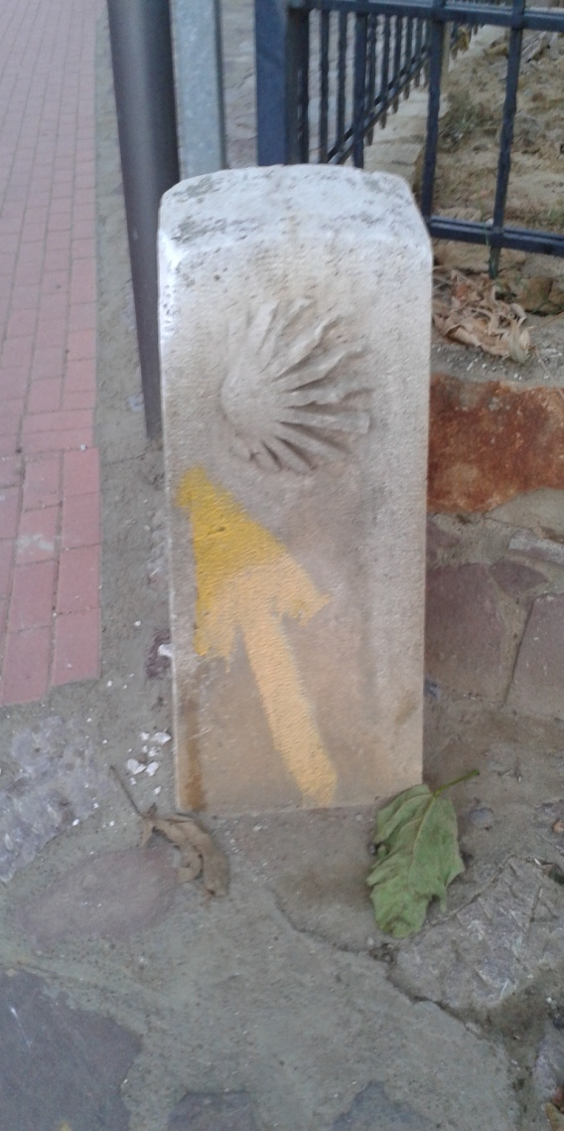

Slide 8
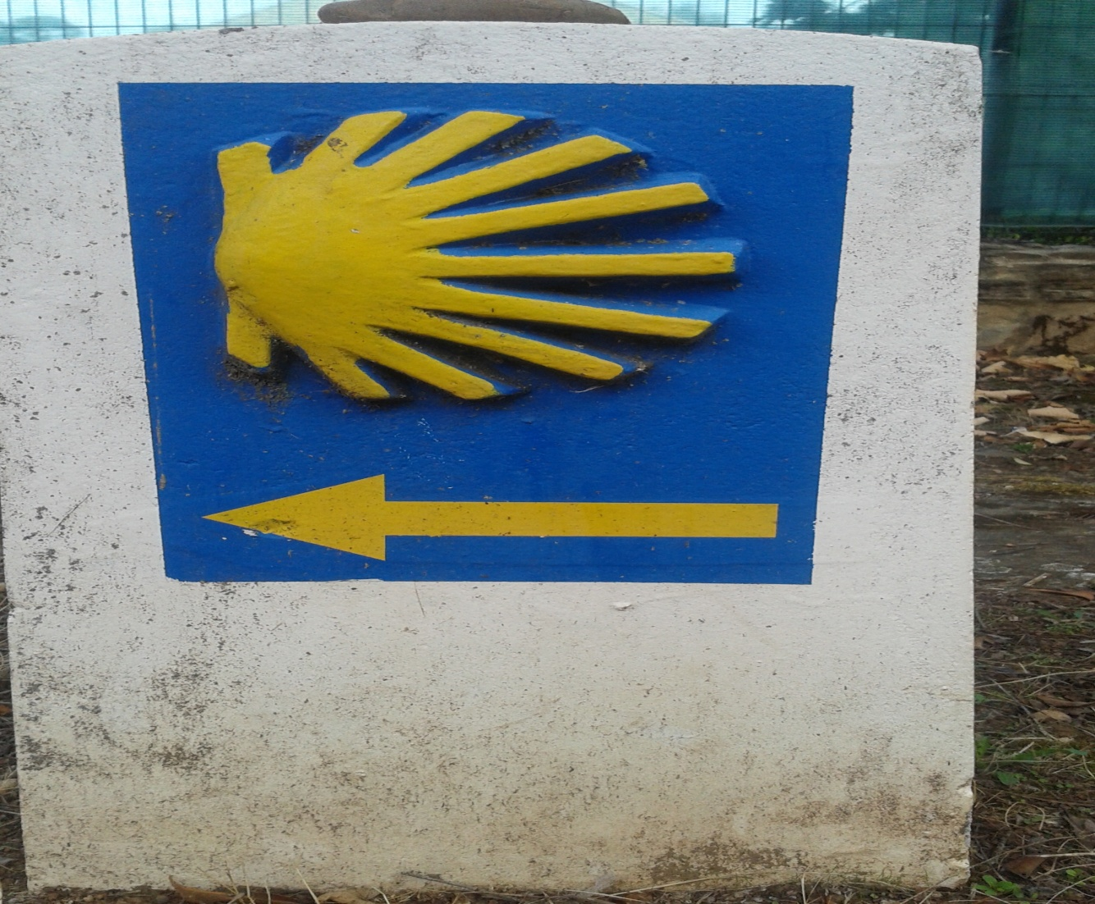
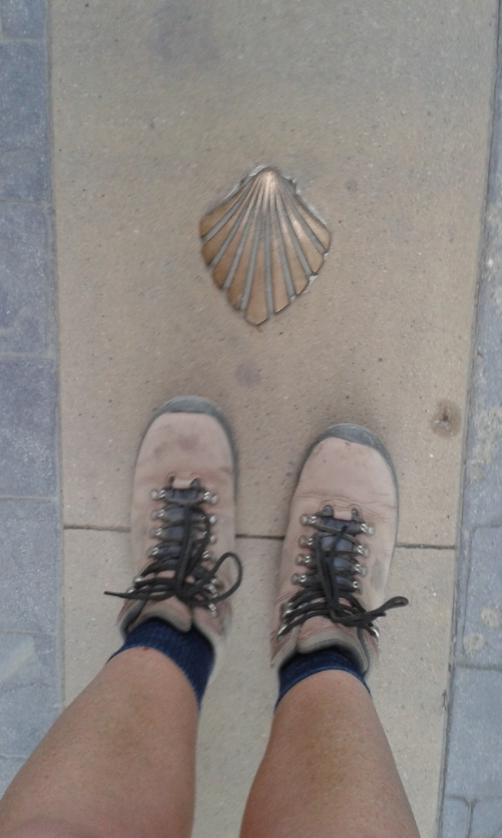

Slide 10
Notes:
Camino passport
5-10 euros or donativo

Slide 14
Notes:
Peregrino menu
8-10 euros mostly including wine
Kitchens provided

Slide 18
2017 Camino Statistics
301,036 people received a Compostela (4,918 in 1990)
93% walkers
7% cyclists

Slide 19
2017 Camino Statistics
The largest single nation represented was Spain: 40%
UK: 3.4%
60%: Camino Frances

Slide 20
My Journey

Slide 23
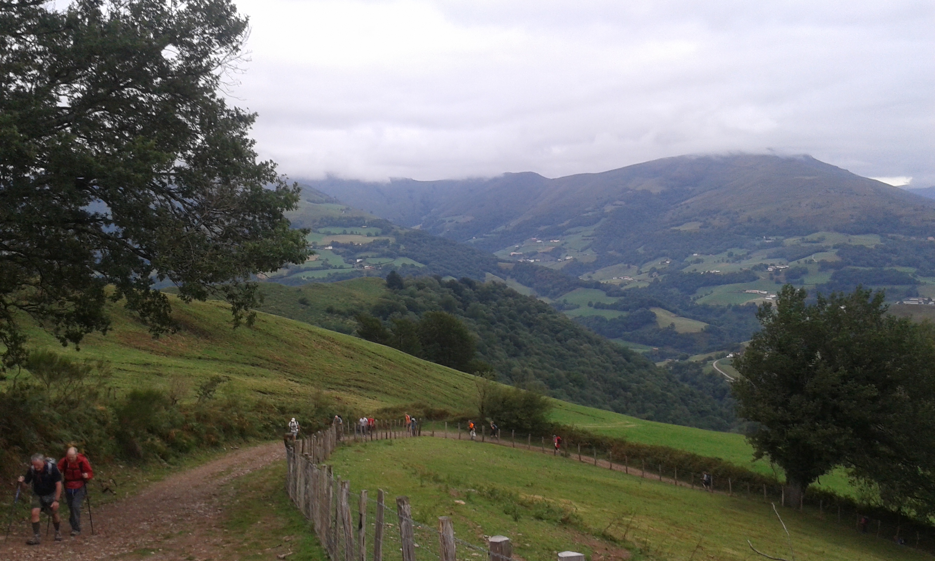

Slide 32
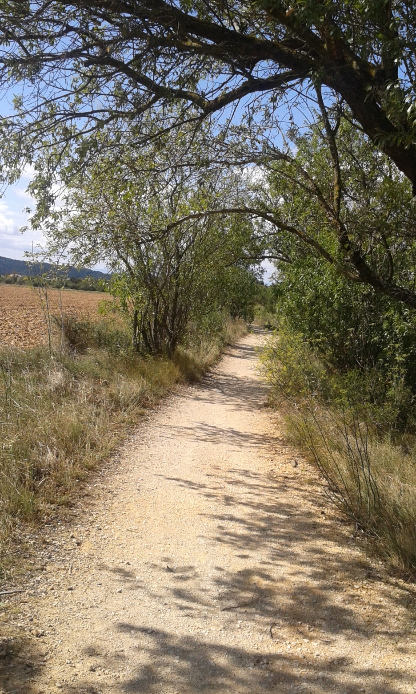

Slide 33
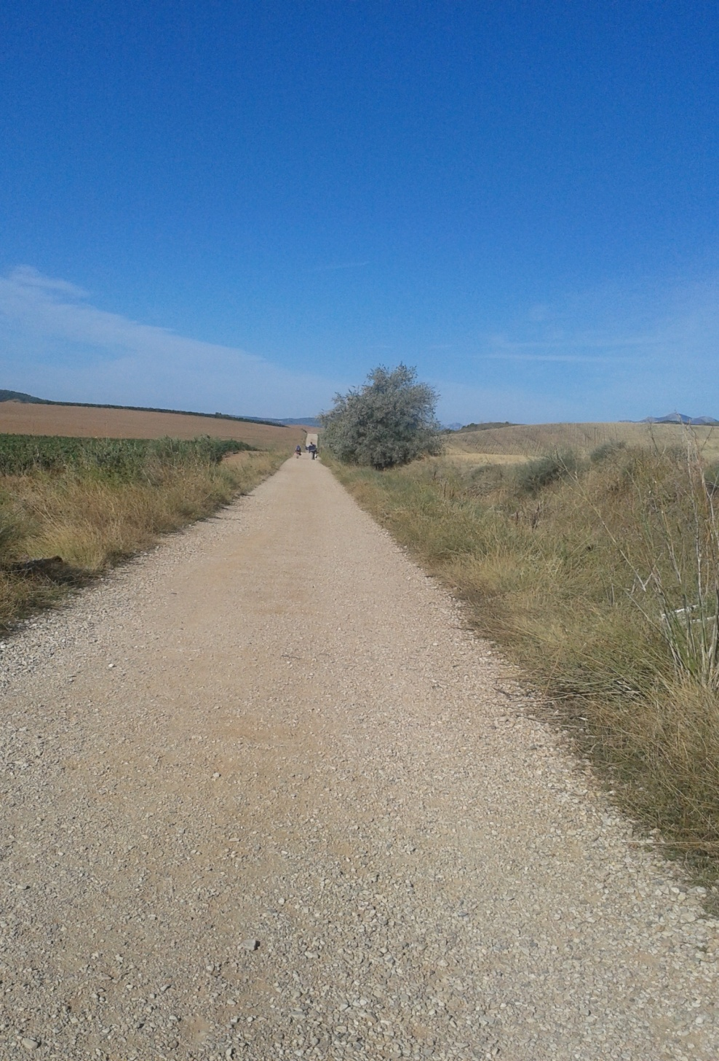

Slide 43
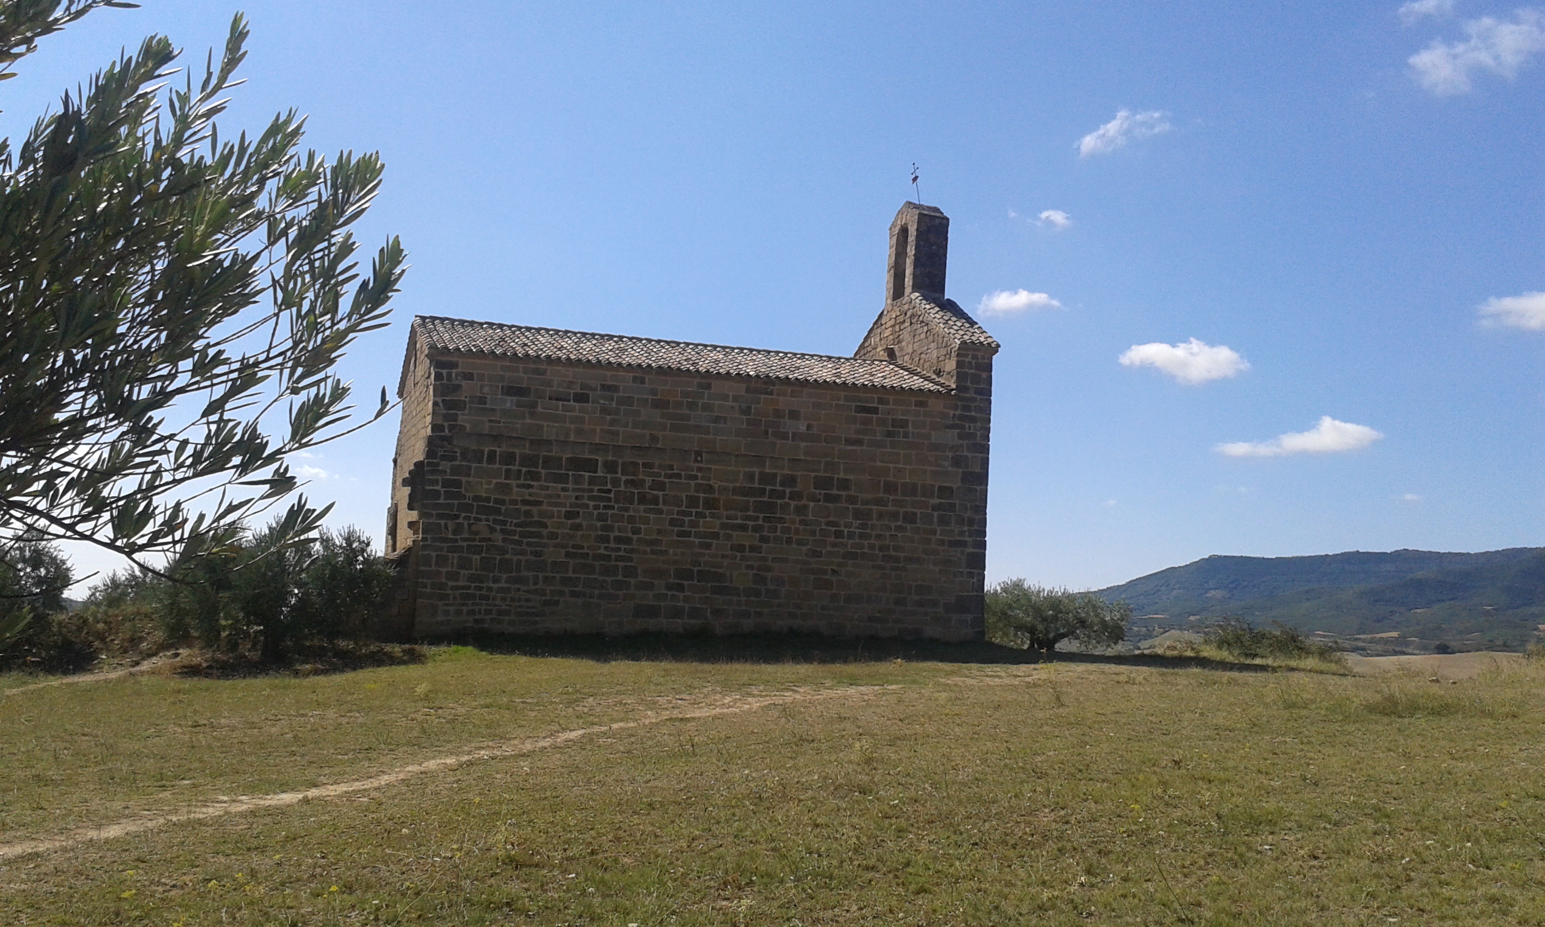

Slide 48
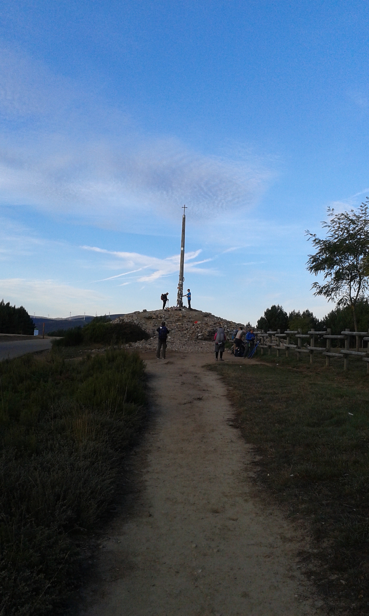

Slide 50
Camino de Santiago
Notes:
Background
Route
How Camino works
My journey

